Slide 1

Federated Learning: A Decentralized Approach for Machine Learning
By
Deekshith Machidi - 2246684
Monish Kamal Batini - 2250471
Ajay Kumar Reddy Poreddy - 2247259
Vinay Kumar Posina - 2248768

Slide 2

Distributed Learning:
Centralized Data: All training data is collected and stored in a central server.
Parallel Training: Model training is distributed across multiple nodes (machines), each processing a subset of the data.
Efficiency Focus: Optimized for speed and scalability when handling large datasets (big data).
Network Communication: Clients communicate with the central server to send and receive data, including model updates.
Challenges:
Latency & Connectivity Issues: Heavy reliance on server-client communication, which may cause delays.
Resource Intensive: Requires powerful servers for centralized model storage and updates.
Example: Building recommendation systems, where millions of user interactions are used to train models in a distributed manner daily.

Slide 3
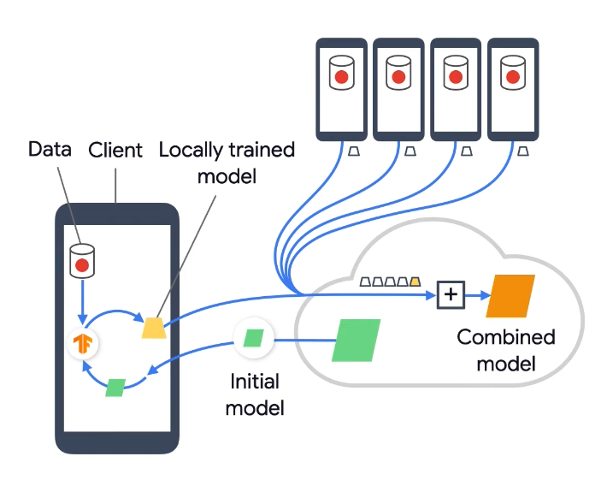
Introduction to Federated Learning
Devices with local data
Local model training
Sending updates to server
Server aggregates model
New global model is distributed back to devices.
Federated Learning Process :

Slide 4
Why Federated Learning?
Data Privacy: No need to upload sensitive data to central servers.
Data Size: Decentralized data can be very large, making centralized training impractical.
Real-World Applications: Training models directly on users' devices (e.g., mobile phones).

Slide 5

Federated Optimization
Decentralized Training: Federated Optimization utilizes techniques that enable collaborative training of machine learning models across multiple devices (clients) without centralizing data, allowing each device to keep its data local.
Privacy-Preserving: By focusing on model updates instead of raw data transfer, Federated Optimization ensures data privacy and security, making it suitable for sensitive applications where user data cannot be shared.

Slide 6
Key properties of Federated Optimization
Non-IID
Unbalanced
Massively distributed
Limited communication

Slide 7
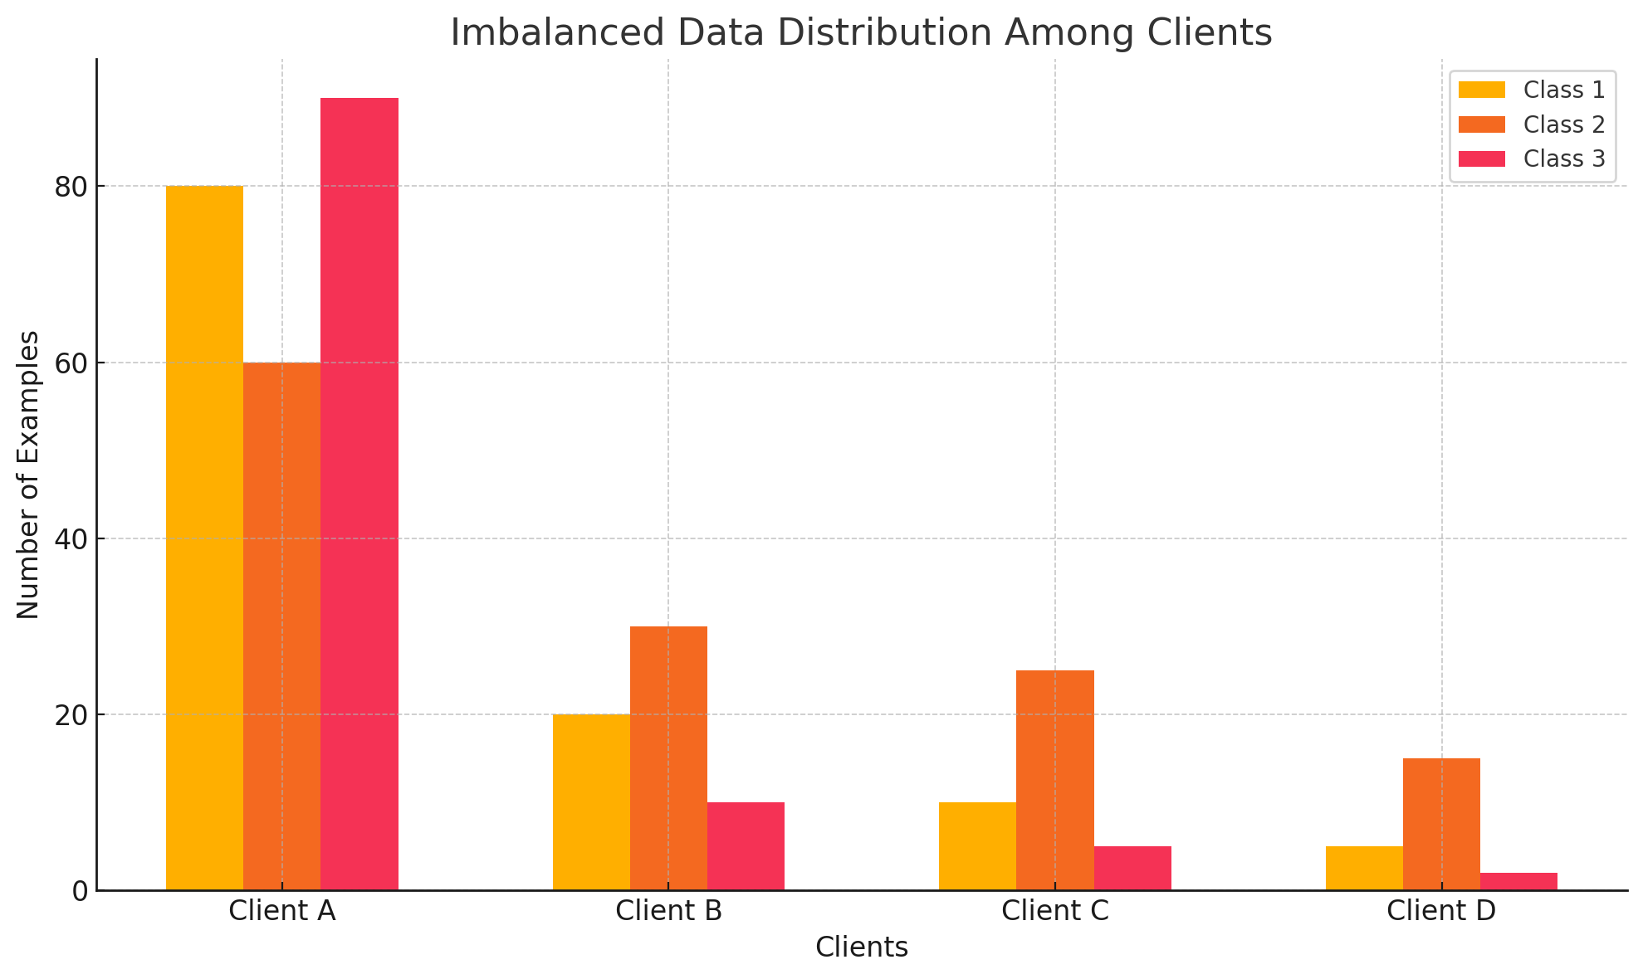
Non-IID and Unbalanced Data
Non-IID: Each client's training data reflects the specific usage patterns of individual users, making it unrepresentative of the overall population distribution.
Unbalanced: Users differ in service usage, resulting in unequal amounts of local training data across clients.
Eg: Phones from speakers of American English will likely be plugged in at different times than speakers of British English

Slide 8

Massively distributed
We expect the number of clients participating in an optimization to be much larger than the average number of examples per client.
Eg: Google Gboard improves typing predictions by training local models on users' devices through federated learning. The aggregated updates enhance the global model without sharing raw data, ensuring privacy.

Slide 9

Limited Communication
Communication is often the bottleneck in federated learning due to limited bandwidth on devices like smartphones.
Eg: Mobile devices are fre- quently offline or on slow or expensive connections.

Slide 10
The FederatedAveraging (FedAvg) Algorithm
FedAvg algorithm process:
Central server sends the global model to clients.
Clients compute local updates using their data.
Local updates sent back to server.
Server averages the updates and sends a new global model.

Slide 11

Federated Learning for Adversarial Defense
Federated Learning helps in scenarios involving adversarial examples where centralizing sensitive data may be risky.
Adversarial Attack Mitigation:
By keeping the training data local, it reduces exposure to adversarial attacks on a centralized dataset.

Slide 12
Advantages of Federated Learning
Data Privacy
Reduced Communication
Scalability

Slide 13
Applications of Federated Learning
Language Models
Image Classification
Healthcare

Slide 14
Demo
Results
Code

Slide 15
Thank You

